Slide 1

Advanced Java Programming (J2EE)
Deepthi S Narayan

Slide 2
J2EE - Java 2 Enterprise Edition – platform independent
Java-centric environment for developing web application.
What is a web application?
What are the major API's of JEE?
How is J2EE a 3-tier architecture?
The gmail example
Static and Dynamic resources
URL
HTTP
What is a Web Server?
Name some of the web servers

Slide 3
Java Software Development Kit (SDK) - J2SE
Download a server
Configure the server
Set up your development environment – CLASSPATH and JAR settings
Test your setup
Deployment - WAR
Create Web application

Slide 4
Limitations of a Web Server
Web server cannot generate dynamic resources
Web server cannot directly interact with DB.

Slide 5
Servlets
Its an API of J2EE and it helps webserver in serving dynamic resources
Servlets are like any other java program.
It accepts web request via webserver and generates
dynamic content and gives it back to webserver.
Webserver inturn gives the dynamic data back to requested user.
Servlets must be accessed via URL.
A Java Servlet is a Java program that extends the capabilities of a server.
Servlets are programs that run on a web or application server and
act as a middle layer between request from Web browser
or other HTTP client and databases or applications on the HTTP server

Slide 6
Servlet functionalities
Read the explicit data sent by the client.
Read the implicit HTTP request data sent by the browser
Generate the results
Send the explicit data to the client.
Send the implicit HTTP response data.

Slide 7
Basic Servlet Structure
Servlets typically extends HttpServlet
GET and POST
Override doGet or doPost
HttpServletRequest and HttpServletResponse
ServletException and IOException
Import javax.servlet and javax.servlet.http

Slide 8
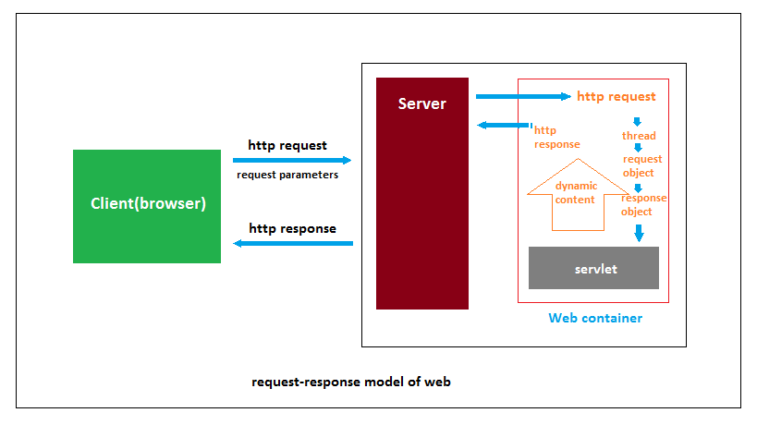

Slide 9
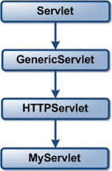
THE SERVLET HIERARCHY

Slide 10
Servlet Packaging
Why are packages used?
Place the files in a sub-directory that matches the intended package name
Insert a package statement in the class file.

Slide 11
Servlet Lifecycle
Init – one-time setup code
public void init() throws ServletException {
}
i) General initializations
ii) Initializations controlled by Initialization Parameters
Service – doGet(), doPost() and other doXXX() methods
public void doGet(HttpServletRequest request, HttpServletResponse response)
throws ServletException, IOException {
//servletcode
}
public void doPost(HttpServletRequest request, HttpServletResponse response)
throws ServletException, IOException {
//servletcode
}
Destroy – clean-up activities
Public void destroy() {

Slide 12
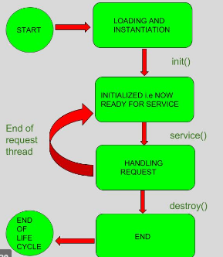
Servlet Lifecycle

Slide 13
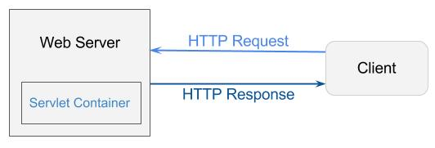
Servlet Container
A web container (also known as a servlet container) is the component of a web server that interacts with Java servlets.
Servlet Container communicates between client Browsers and the servlets.
In Java, Servlet container (also known as a Web container) generates dynamic web pages.

Slide 14
Servlet Container Advantages
Communications support
Lifecycle management
Multithreading support
Declarative security
JSP support

Slide 15
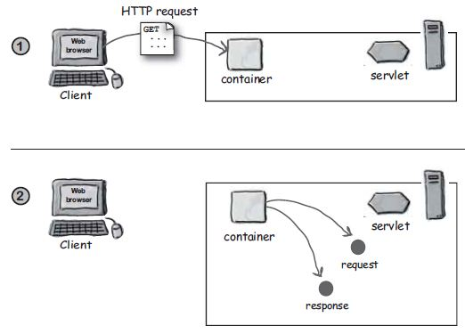
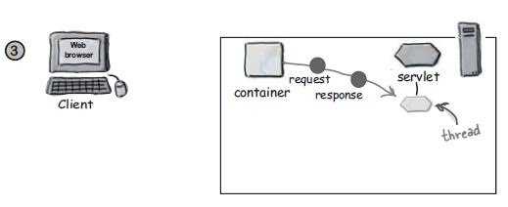
CONTAINERS

Slide 16
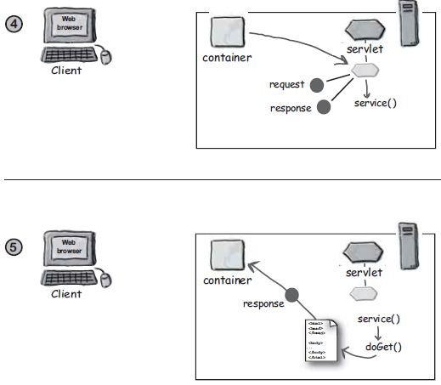
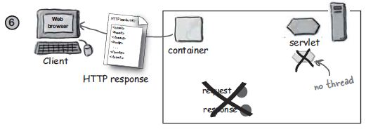
CONTAINERS

Slide 17
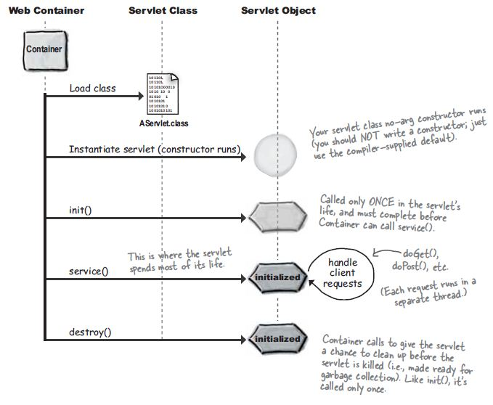

Slide 18
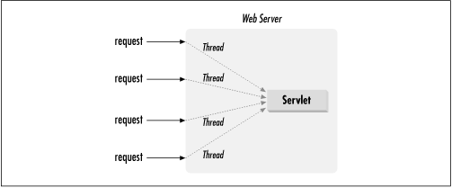

Slide 19
The SingleThreadModelInterface
Multiple threads can concurrently access same servlet object.
Prevent multithreaded access by having servlet implement SingleThreadModel interface
Queues up all requests
Creation of pool of multiple instances
Local variables, instance variables – is OK
Class variables?
Drawback of this -
i) Performance issue
ii) Pool of instances

Slide 20
Use SingleThreadModel
Ex: public class Sample extends HTTPServlet implements SingleThreadModel {
}
Synchronize the code explicitly
synchronized(this) {
...
...
...
}
Are Servlets Multi-threaded?

Slide 21
HANDLING THE CLIENT REQUEST: FORM DATA
Form Data – query string
1. Use the <form> element to create an HTML form
2. Use input elements to collect user data
3. Place a submit button at the end of the form.
Why Servlets?
Extracting the form data is tedious...
a) Before Servlets, CGI programs read data in different ways for GET and POST
b) Separation of parameter names and parameter values cutting it at the &
c) URL-decode the values ( ~ = %7E)
d) Values can be omitted or sometimes a parameter can appear more than once

Slide 22
Reading form data from Servlets
Form data and parameters – The parameters specified in a form (html)
can be retrieved with some of the methods provided by the Servlet.
getParameter() takes case sensitive parameter name as an argument.
(Present in HttpServletRequest)
getParameterValues() – returns array of Strings.
(Present in HttpServletRequest)
getParameterNames() – gets the list of parameter names in the
form of Enumeration.
(Present in ServletRequest interface)
Reading Raw Form Data -
getReader() or getInputStream()
Useful when -
i) Data comes from a custom client – applet
ii) Data comes from an uploaded file. <input type=”file” ... />

Slide 23
Example Programs
ThreeParams – reading input using request.getParameter()
ShowParameters – reading input using request.getParameterNames()
And then use hasMoreElements() and nextElement() to read each input element.

Slide 24
Parameters are missing or malformed
What should the servlet do when the user fails to supply necessary information?
- Use default values
- Redisplay the form( prompt the user for missing values)
When examining the request parameters, check the three conditions -
1) The value is null – to avoid NullPointerException
2) The value is an empty string
String param = request.getParameter(“someName”);
if((param==null) || (param.trim().equals(“”))) {
doSomethingForMissingValues(...);
} else {
doSomethingWithParameter(param);
}
}
3) The value is a non-empty string of the wrong format

Slide 25
Filtering Strings for HTML-specific Characters
HTML Character entities - <, >, “, &
Note the special characters and use the standard HTML replacements.
Two cases where this is not easy -
1) When string is derived from a program segment or another source
which is already in some format.
2) When the string is derived from the HTML form data
Code for filtering
Strings are immutable.
Always use StringBuffer when modification is involved.
Ex: ServletUtilities, CodeForm1.html, BadCodeServlet.java, CodeForm2.html, GoodCodeServlet.java

Slide 26
Redisplay Options
Have the same servlet present the form, process the data and present the results
Have one servlet present the form, have a second servlet process data and
present the results
Syntax of sendRedirect() method
public void sendRedirect(String URL)throws IOException;
Have a JSP page manually present the form, have a servlet or JSP page process
the data and present the results
Have a JSP page present the form, automatically filling in the fields with values
obtained from a data object. Have a servlet or JSP page process the data and
present the results.
Example Program – RedirectServlet

Slide 27
Demonstrating RequestDispatcher
Files to be created :
requestdispatch.html will have form fields to get user information.
Validate.java will validate the data entered by the user.
Welcome.java will be the welcome page.
web.xml, the deployment descriptor.

Slide 28
HTTP Request Header Sample
GET /servlet/Search?keywords=servlets+jsp HTTP/1.1
Accept: image/gif, image/jpg, */*
Accept-Encoding: gzip
Connection: Keep-Alive
Cookie: userID = id12334
Host: www.somebookstore.com
Referer: http://www.somebookstore.com/findbooks.html
User-Agent: Mozilla4.0(compatible; MSIE 6.0; Windows NT 5.0)
Fiddler demo

Slide 29
HANDLING THE CLIENT REQUEST: HTTP REQUEST HEADERS
HTTP Headers:
HTTP headers are set by a client to give information to a server about software environment that client is using.
The HTTP headers can be accessed from the servlet by calling the following methods:
1. getHeader(String name)
2. getHeaders(String name)
3. getHeaderNames()
4. getIntHeader(String name)
5. getDateHeader(String name)

Slide 30
Other Request Header methods include -
getCookies() - returns the contents of the Cookie header
getAuthType() and getRemoteUser() - breaks Authorization header into its
component pieces.
getContentLength() - returns the value of Content-Length header
getContentType() - returns the value of Content-Type header

Slide 31
For information on the first line in the HTTP Request Header -
getMethod() - returns the main request method (normally GET or POST, HEAD, PUT, DELETE etc)
getRequestURI() - returns part of the URL that comes after the host and port but before the form data.
getQueryString() - returns the form data
getProtocol() - returns the third part of the request line HTTP/1.0 ot HTTP/1.1

Slide 32
Important HTTP1.1 Request Headers
Accept – A servlet that can return a resource in more than one format can examine the 'Accept' header to decide which format to use.
Ex. Image formats
Accept-Charset – Ex: ISO – 8859-1, UTF-8
Accept-Encoding – Free to encode the page by using the format specified
Content - Encoding response header is sent to indicate that it has done so.
Accept-Language – Specifies the clients preferred languages
Ex. en-us, de-at, en-gb etc
Authorization – Used by clients to identify themselves when accessing password-Protected web pages.
Connection – Indicates whether the client can handle persistent HTTP connections.
Content-Length – Applicable only to POST requests and gives the size of the post data in bytes

Slide 33
Cookie – Returns cookies to servers that previously sent them to the browser.
Host – Indicates host and port as given in the original URL.
If-Modified-Since – Indicates that the client wants the page only if it has been changed after the specified date
If-Unmodified-Since – Specifies that the operation should succeed only if the document is older than the specified date.
Typically, If-Modified-Since is used for GET requests(“give me the document only if it is newer than my cached version”), whereas If-Unmodified-Since is used for PUT requests(“update this document only if nobody has changed it since I generated it”)
Referer – Indicates the URL of the referring web page. Useful for tracking where request came from.
User-Agent – Identifies the browser or other client making the request and can also be used to return different content to different types of browsers.
A5C3HI2RU

Slide 34
Sending Compressed Web Pages
Gzip – is a text compression scheme that can dramatically reduce the size of HTML (or plain text) pages.
Accept-Encoding request header
Differentiating among different browser types using “User-Agent”
BrowserInsult.java and WrongDestination.java
Changing the page according to how the user got there – using Referer

Slide 35
GENERATING THE SERVER RESPONSE: HTTP STATUS CODES
HTTP/1.1 200 OK
Content-Type: text/html
Header2:...
.....
Header N:...
(Blank line)
<!DOCTYPE...>
<html>
<head>...</head>
<body>
...
...
</body>
</html>

Slide 36
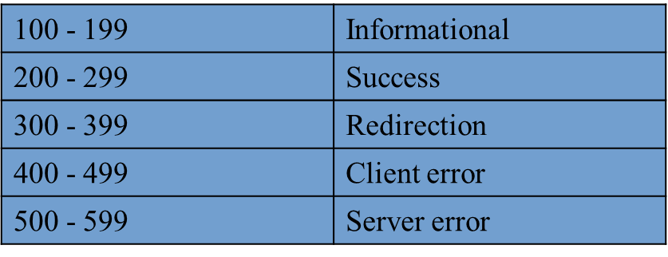
Specifying Status codes
response.setStatus()
response.sendRedirect()
response.sendError()
Setting 302 and 404 Status codes: sendRedirect and sendError
public void sendRedirect(String url)
public void sendError(int code, String message)

Slide 37
Syntax for sendRedirect()
public void sendRedirect(String URL)throws IOException;
What is Servlet forward()?
request.getRequestDispacher("servlet2").forward(request,response);

Slide 38
GENERATING THE SERVER RESPONSE: HTTP RESPONSE HEADERS
Setting Response Headers from Servlets
- setHeader(String headerName, String headerValue) method of
HttpServletResponse
- setDateHeader(String header, long milliseconds) – saves translating a Java
date in milliseconds since 1970
- setIntHeader(String header, int headerValue) – converts an int to a String
before inserting it into a header.
Common header related methods -
setContentType(String mimeType)
setContentLength(int length)
addCookie(Cookie c)
sendRedirect(String address)

Slide 39
Important HTTP1.1 Response Headers
Allow – specifies the request methods(GET,POST etc) that the server supports.
Cache-Control – Tells the browser, the circumstances in which the response document can be safely cached.
public, private, no-cache, no-store, must-revalidate, proxy-revalidate, max-age = xxx, s-max-age=xxx
Connection - close (not to use persistent HTTP connections)
Content-Disposition – Browser asks the user to save the response to disk in a file of the given name
Content-Disposition: attachment; filename=some-file-name
Content-Encoding – The way in which page was encoded during transmission.
Content-Language – Signifies the language in which document is written.
Content-Length – Indicates the number of bytes in the response.

Slide 40
Content-Type – header gives the MIME type of the response document.
response.setContentType(maintype/subtype)
Expires – Specifies the time at which the content should be considered out-of-date and thus no longer be cached.
Last-Modified – Indicates when the document was last changed.
Location – Notifies the browser of the document address. Usually used with 300's status codes (sendRedirects)
Pragma – HTTP1.0 – clients not to cache the document.
Refresh – Specifies how soon the browser should ask for an updated page.
Ex: response.setIntHeader(“Refresh”, 30);
Retry-After – Tells the client how soon it can repeat its request
Normally used with 503(Service Unavailable)

Slide 41
Set-Cookie – Specifies the cookie associated with the page.
WWW-Authenticate – mostly included with 401(Unauthorized) status code. It tells the browser the authorization type(BASIC or DIGEST). Used for security mechanisms.
AC7EL2PR2SW

